Slide 1
AUTONOMOUS CARS SOFTWARE

Slide 2
Role of VPUs in Autonomous Vehicles
VPUs (Vision Processing Units) are indeed used in autonomous car systems software. They play a critical role in the perception stack of self‑driving technology. Here’s how:
Computer Vision Tasks: VPUs are optimized for image and video processing. In cars, they handle real‑time tasks like:
Lane detection
Traffic sign recognition
Pedestrian and cyclist detection
Object classification (cars, trucks, obstacles)

Slide 3
Efficiency: VPUs consume less power than GPUs while still delivering high throughput for vision workloads. This is important in cars where energy efficiency matters.
Integration: VPUs are often paired with CPUs and GPUs in heterogeneous computing systems inside autonomous vehicles.
CPU: General control logic, decision making.
GPU: Heavy parallel math (AI models, sensor fusion).
VPU: Specialized vision inference, especially for camera feeds.

Slide 4
Examples in Automotive Use
Intel Movidius Myriad VPU has been used in drones and automotive vision systems.
Mobileye (owned by Intel) integrates vision processors for advanced driver‑assistance systems (ADAS) and autonomous driving.
VPUs help process multiple camera streams simultaneously — critical for 360° awareness in cars.
⚖️ Why Not Just GPU?
GPUs are powerful but power‑hungry.
VPUs are lighter, more efficient, and specialized for vision, making them ideal for embedded automotive systems where thermal and energy constraints exist.

Slide 5
please show you how matrix operations (linear algebra) are the mathematical backbone of what VPUs do
So yes, VPUs are a key part of autonomous car software, working alongside CPUs and GPUs to deliver safe, real‑time perception.
Since you’re watching linear algebra videos right now, I can show you how matrix operations (linear algebra) are the mathematical backbone of what VPUs do — for example, in convolutional neural networks used for image recognition. Would you like me to connect those dots so you see how the math you’re studying powers self‑driving cars?

Slide 6
please show you how matrix operations (linear algebra) are the mathematical backbone of what VPUs do
1. Images as Matrices
A digital image is essentially a matrix of pixel values.
Example: A grayscale image = matrix of intensity values.
A color image = three matrices (R, G, B channels).
VPUs process these matrices in real time from car cameras.
🔄 2. Convolution (Matrix Multiplication)
Core of computer vision = convolutional neural networks (CNNs).
Convolution = sliding a small matrix (filter/kernel) over the image matrix.
Mathematically: multiply and sum values → detect edges, shapes, patterns.
VPUs accelerate these convolution operations massively.

Slide 7
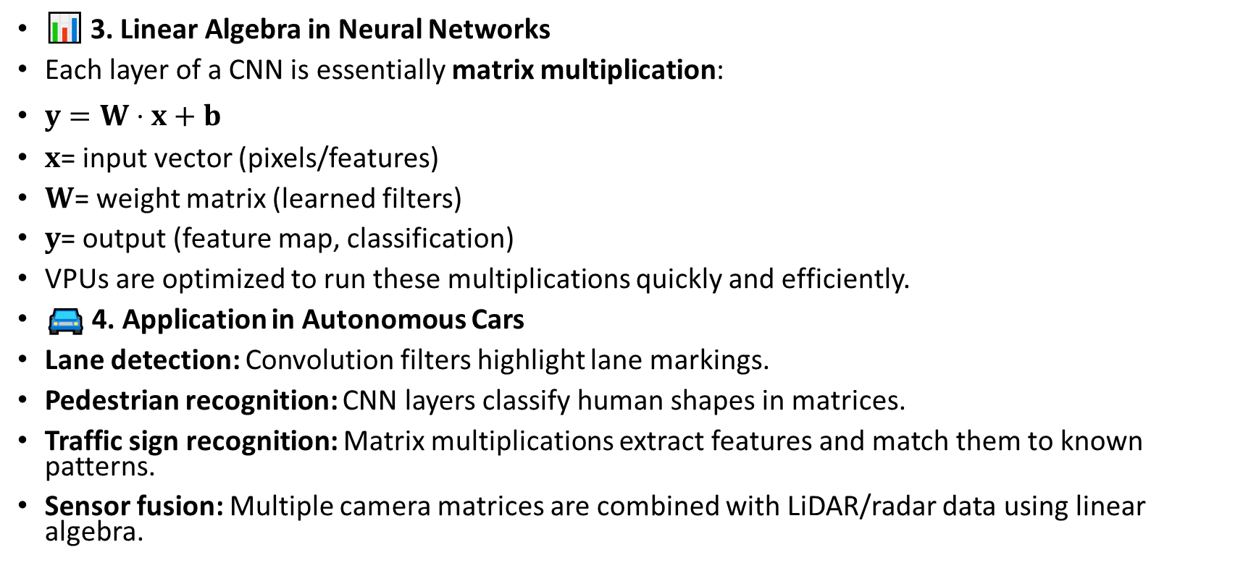
please show you how matrix operations (linear algebra) are the mathematical backbone of what VPUs do
📊 3. Linear Algebra in Neural Networks
Each layer of a CNN is essentially matrix multiplication:
$y=W⋅x+b$
$x$= input vector (pixels/features)
$W$= weight matrix (learned filters)
$y$= output (feature map, classification)
VPUs are optimized to run these multiplications quickly and efficiently.
🚘 4. Application in Autonomous Cars
Lane detection: Convolution filters highlight lane markings.
Pedestrian recognition: CNN layers classify human shapes in matrices.
Traffic sign recognition: Matrix multiplications extract features and match them to known patterns.
Sensor fusion: Multiple camera matrices are combined with LiDAR/radar data using linear algebra.

Slide 8
Why VPUs?
GPUs can do this too, but VPUs are specialized:
Lower power consumption.
Optimized for vision workloads (matrix ops on images).
Ideal for embedded automotive systems.
So, every time a self‑driving car’s camera “sees” something, the VPU is crunching matrix multiplications and convolutions to turn raw pixels into meaningful perception — all powered by the linear algebra you’re studying.

Slide 9
since you’re watching the Essence of Linear Algebra series on YouTube, would you like me to map one of those vector/matrix concepts (like dot product or transformation) directly to a vision task in autonomous cars, so you see the math in action?
please map one of those vector/matrix concepts (like dot product or transformation) directly to a vision task in autonomous cars,
let’s map a linear algebra concept directly to a vision task in autonomous cars so you see the math in action:

Slide 10
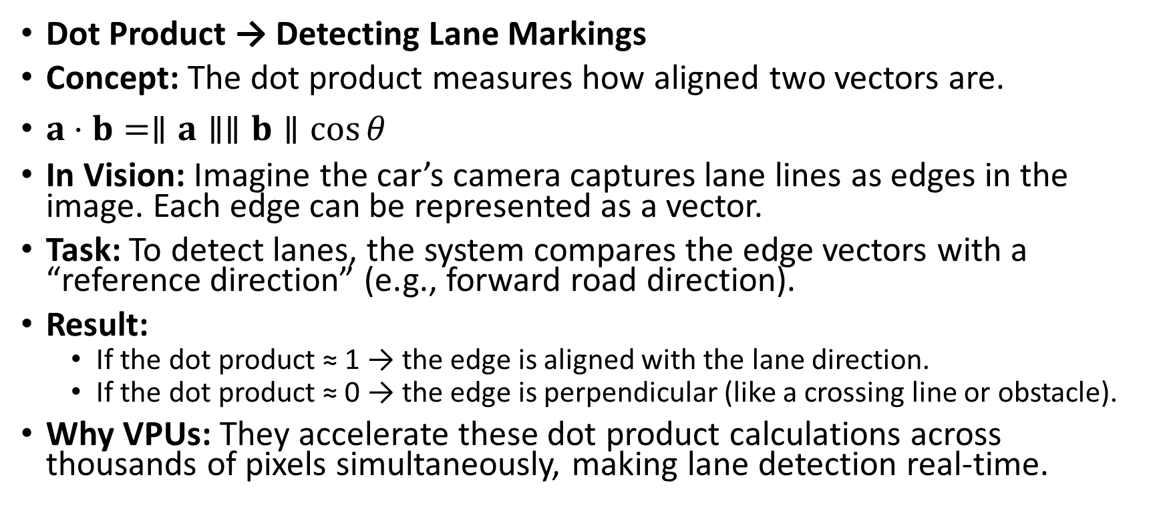
let’s map a linear algebra concept directly to a vision task in autonomous cars so you see the math in action:
Dot Product → Detecting Lane Markings
Concept: The dot product measures how aligned two vectors are.
$a⋅b=∥a∥∥b∥\cos{θ}$
In Vision: Imagine the car’s camera captures lane lines as edges in the image. Each edge can be represented as a vector.
Task: To detect lanes, the system compares the edge vectors with a “reference direction” (e.g., forward road direction).
Result:
If the dot product ≈ 1 → the edge is aligned with the lane direction.
If the dot product ≈ 0 → the edge is perpendicular (like a crossing line or obstacle).
Why VPUs: They accelerate these dot product calculations across thousands of pixels simultaneously, making lane detection real‑time.

Slide 11
Matrix Transformation → Object Recognition
Concept: A transformation matrix rotates, scales, or translates vectors.
In Vision: When a pedestrian appears at different angles or scales, the system applies transformation matrices to normalize the image.
Task: VPUs use these transformations so the neural network can recognize “pedestrian” regardless of position, size, or orientation.
Result: Robust recognition even if the person is far away, close up, or partially rotated.
🚘 Why This Matters in Cars
Dot product: Helps align features like lanes, road edges, and vehicle orientation.
Transformations: Normalize objects for consistent recognition.
Together, these linear algebra operations are the mathematical backbone of perception in autonomous driving — and VPUs are specialized to crunch them efficiently.

Slide 12
Step‑by‑Step Lane Detection Pipeline (with Linear Algebra)
Image Capture (Camera Input)
The car’s camera produces an image → represented as a matrix of pixel values.
Each pixel intensity is a number, so the whole image is essentially a big matrix.
Preprocessing (Filtering & Edge Detection)
Apply convolution filters (small matrices) across the image matrix.
These filters highlight edges (like lane markings).
Mathematically: multiply and sum overlapping matrix regions.

Slide 13
3. Feature Extraction (Dot Products)
Each detected edge can be represented as a vector.
Compute the dot product between the edge vector and a reference direction (e.g., forward road axis).
If the dot product ≈ 1 → edge aligns with lane direction.
If ≈ 0 → edge is perpendicular (crosswalk, obstacle).
4. Transformation (Perspective Correction)
Use matrix transformations (rotation, scaling, translation) to adjust the image.
Example: “bird’s‑eye view” transformation to flatten the road for easier lane detection.
Transformation matrices ensure lanes are detected consistently regardless of camera angle.

Slide 14
Lane Modeling (Polynomial Fit)
Once lane points are identified, fit them with a curve (often quadratic).
This uses linear algebra regression techniques to minimize error between detected points and the lane model.
Decision Layer (Integration with Control)
The lane model feeds into the car’s path planning.
VPUs accelerate all the above matrix operations so the car can react in real

Slide 15
What Does “Matrix Ops” Mean?
Matrix operations (matrix ops) = mathematical manipulations of matrices.
Common ones in vision tasks:
Multiplication: combining filters with image patches.
Dot product: measuring alignment of vectors.
Transformation: rotating/scaling/translating coordinates.
Addition/Subtraction: adjusting brightness or combining feature maps.
In short, “matrix ops” are the core math routines that VPUs/GPU hardware crunch billions of times per second to make vision tasks possible.
So, every time an autonomous car “sees” a lane, it’s really doing a chain of matrix multiplications, dot products, and transformations — and VPUs are the specialized chips that make this math fast and efficient.

Slide 16
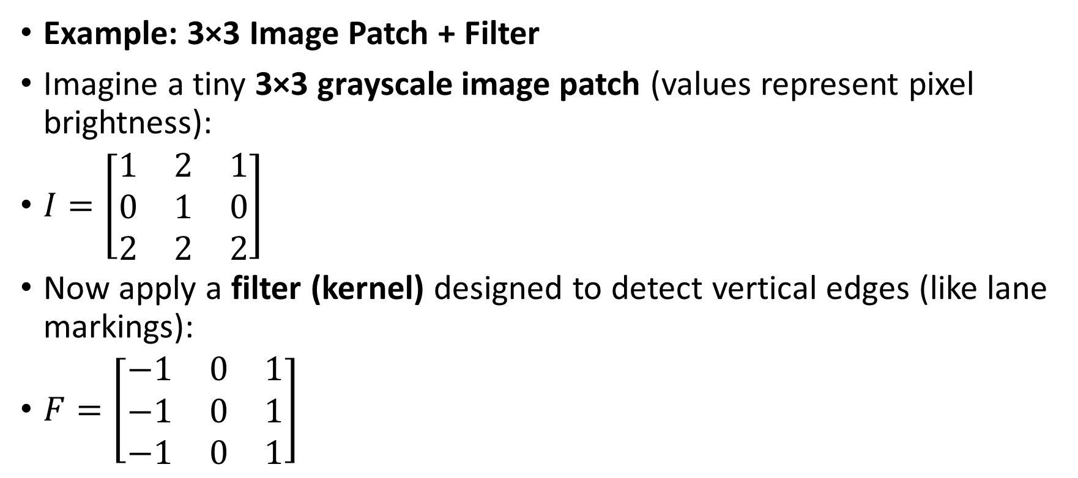
please illustrate this with a simple numeric example (like a 3×3 image patch and a filter matrix)
Example: 3×3 Image Patch + Filter
Imagine a tiny 3×3 grayscale image patch (values represent pixel brightness):
$I=\left[\begin{matrix}1 & 2 & 1 \\ 0 & 1 & 0 \\ 2 & 2 & 2\end{matrix}\right]$
Now apply a filter (kernel) designed to detect vertical edges (like lane markings):
$F=\left[\begin{matrix}−1 & 0 & 1 \\ −1 & 0 & 1 \\ −1 & 0 & 1\end{matrix}\right]$

Slide 17
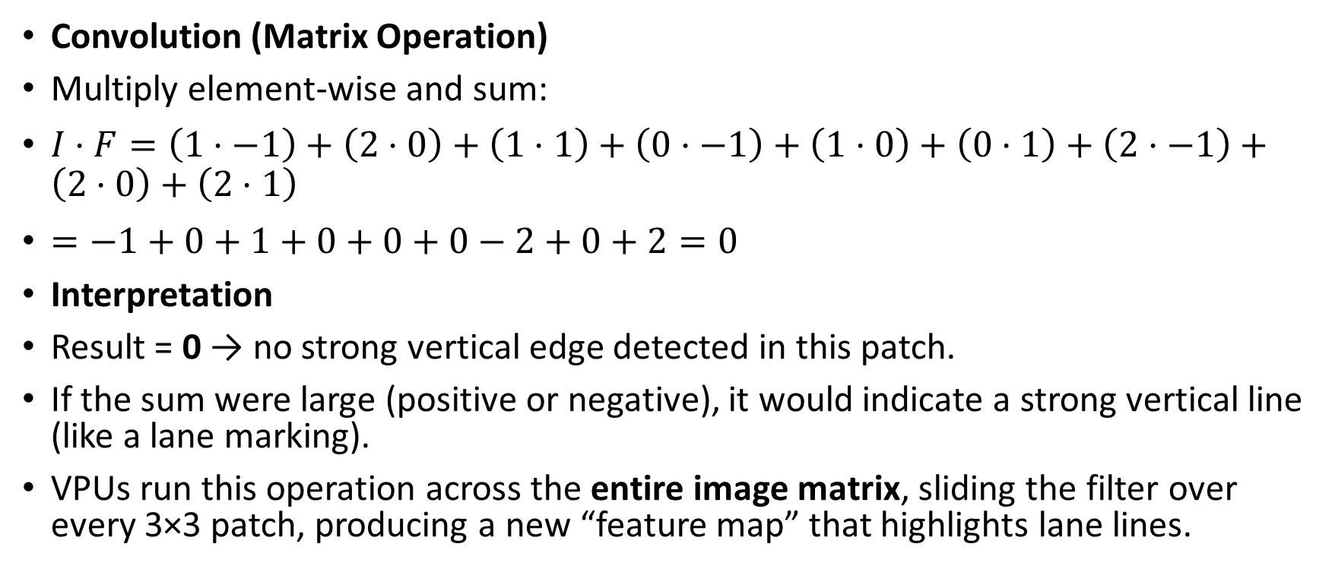
Convolution (Matrix Operation)
Multiply element‑wise and sum:
$I⋅F=\left(1⋅−1\right)+\left(2⋅0\right)+\left(1⋅1\right)+\left(0⋅−1\right)+\left(1⋅0\right)+\left(0⋅1\right)+\left(2⋅−1\right)+\left(2⋅0\right)+\left(2⋅1\right)$
$=−1+0+1+0+0+0−2+0+2=0$
Interpretation
Result = 0 → no strong vertical edge detected in this patch.
If the sum were large (positive or negative), it would indicate a strong vertical line (like a lane marking).
VPUs run this operation across the entire image matrix, sliding the filter over every 3×3 patch, producing a new “feature map” that highlights lane lines.

Slide 18
What “Matrix Ops” Means Here
Matrix ops = all the math you do with matrices:
Multiplication (like above, filter × image patch).
Dot product (measuring alignment of vectors).
Transformations (rotating/scaling coordinates for perspective correction).
In vision tasks, these are repeated millions of times per second — VPUs are specialized to crunch them efficiently.
So in lane detection, every camera frame is broken into patches, filters (matrices) are applied, and the resulting numbers tell the system where lane lines are. That’s the “matrix ops” backbone in action.

Slide 19
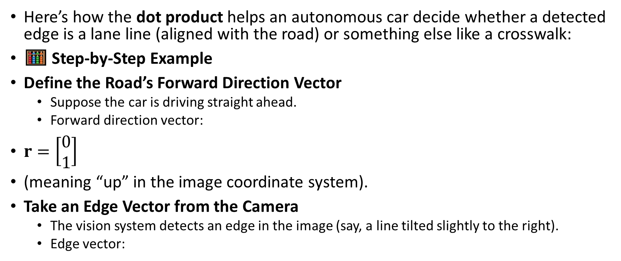
please show how you how a dot product specifically helps align detected edges with the road’s forward direction (so the car knows which lines are lanes vs. crosswalks)?
Here’s how the dot product helps an autonomous car decide whether a detected edge is a lane line (aligned with the road) or something else like a crosswalk:
🧮 Step‑by‑Step Example
Define the Road’s Forward Direction Vector
Suppose the car is driving straight ahead.
Forward direction vector:
$r=\left[\begin{matrix}0 \\ 1\end{matrix}\right]$
(meaning “up” in the image coordinate system).
Take an Edge Vector from the Camera
The vision system detects an edge in the image (say, a line tilted slightly to the right).
Edge vector:

Slide 20
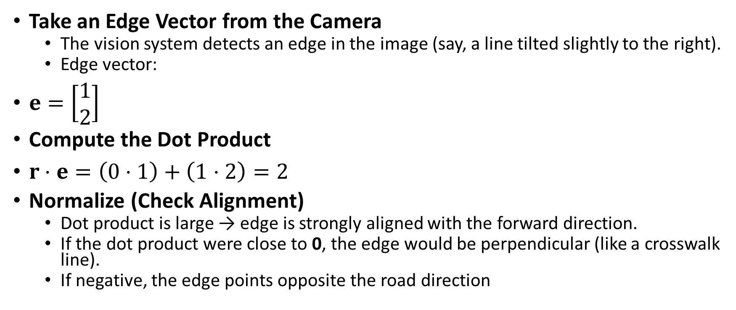
Take an Edge Vector from the Camera
The vision system detects an edge in the image (say, a line tilted slightly to the right).
Edge vector:
$e=\left[\begin{matrix}1 \\ 2\end{matrix}\right]$
Compute the Dot Product
$r⋅e=\left(0⋅1\right)+\left(1⋅2\right)=2$
Normalize (Check Alignment)
Dot product is large → edge is strongly aligned with the forward direction.
If the dot product were close to 0, the edge would be perpendicular (like a crosswalk line).
If negative, the edge points opposite the road direction

Slide 21
Interpretation in Lane Detection
High dot product (≈1 after normalization): Edge is parallel to the road → likely a lane marking.
Low dot product (≈0): Edge is perpendicular → likely a crosswalk or obstacle.
Negative dot product: Edge points backward → not relevant for lane guidance.
⚡ Why VPUs Matter
VPUs accelerate these dot product checks across thousands of edges per frame, allowing the car to instantly filter which lines are lanes and which are not. This is how linear algebra directly powers perception in autonomous driving.
So, the dot product is the math test for alignment: it tells the car whether a detected line is part of the lane structure or something else in the scene.

Slide 22
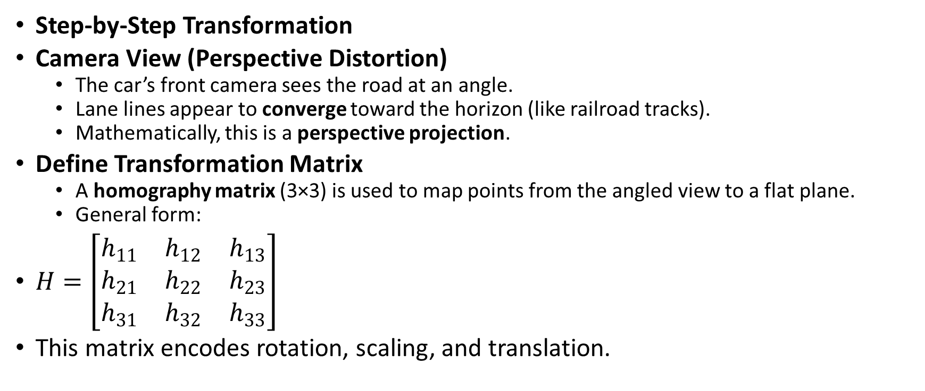
please sketch how matrix transformations (rotation/scaling) are used to convert the camera’s angled road view into a “bird’s‑eye view,”
Step‑by‑Step Transformation
Camera View (Perspective Distortion)
The car’s front camera sees the road at an angle.
Lane lines appear to converge toward the horizon (like railroad tracks).
Mathematically, this is a perspective projection.
Define Transformation Matrix
A homography matrix (3×3) is used to map points from the angled view to a flat plane.
General form:
$H=\left[\begin{matrix}h_{11} & h_{12} & h_{13} \\ h_{21} & h_{22} & h_{23} \\ h_{31} & h_{32} & h_{33}\end{matrix}\right]$
This matrix encodes rotation, scaling, and translation.

Slide 23
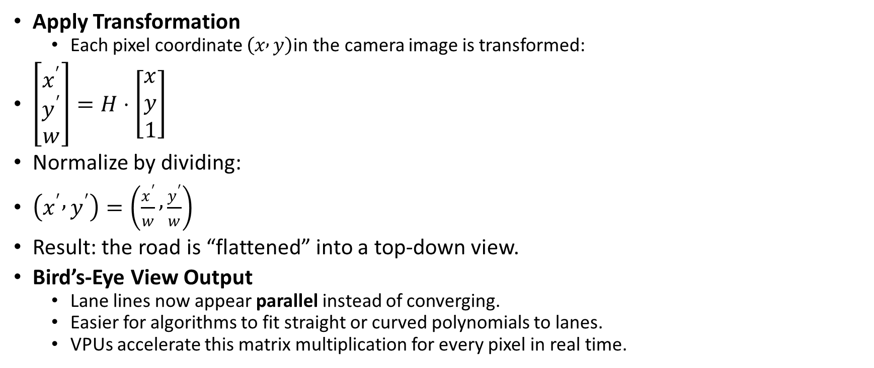
Apply Transformation
Each pixel coordinate $\left(x , y\right)$in the camera image is transformed:
$\left[\begin{matrix}x^{′} \\ y^{′} \\ w\end{matrix}\right]=H⋅\left[\begin{matrix}x \\ y \\ 1\end{matrix}\right]$
Normalize by dividing:
$\left(x^{′} , y^{′}\right)=\left(\frac{x^{′}}{w} , \frac{y^{′}}{w}\right)$
Result: the road is “flattened” into a top‑down view.
Bird’s‑Eye View Output
Lane lines now appear parallel instead of converging.
Easier for algorithms to fit straight or curved polynomials to lanes.
VPUs accelerate this matrix multiplication for every pixel in real time.

Slide 24
Why It Matters
In the angled camera view, lane lines are distorted.
After transformation, the car sees the road as if from above → making lane detection and path planning much more accurate.
This is why linear algebra (matrix ops) is essential: it literally reshapes the car’s vision.
So, matrix transformations are the math that turns a distorted camera image into a usable bird’s‑eye view for lane detection.

Slide 25
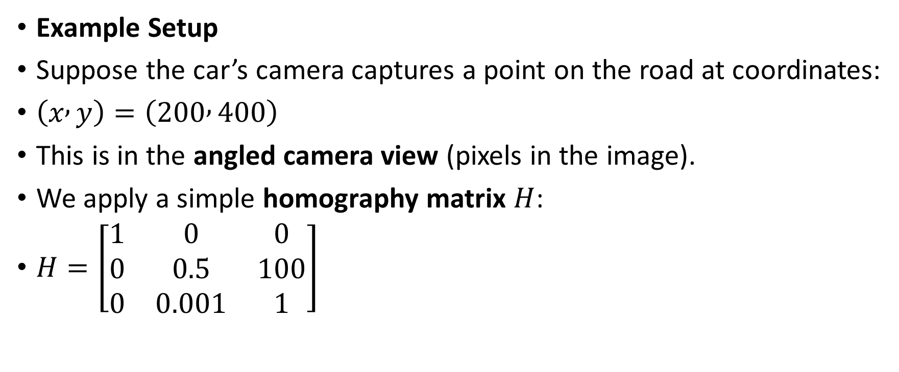
PLEASE illustrate this with a small numeric example (say, a 2D point transformed by a homography matrix) so you can see how coordinates shift from angled view to bird’s‑eye view?
Example Setup
Suppose the car’s camera captures a point on the road at coordinates:
$\left(x , y\right)=\left(200 , 400\right)$
This is in the angled camera view (pixels in the image).
We apply a simple homography matrix $H$:
$H=\left[\begin{matrix}1 & 0 & 0 \\ 0 & 0.5 & 100 \\ 0 & 0.001 & 1\end{matrix}\right]$

Slide 26
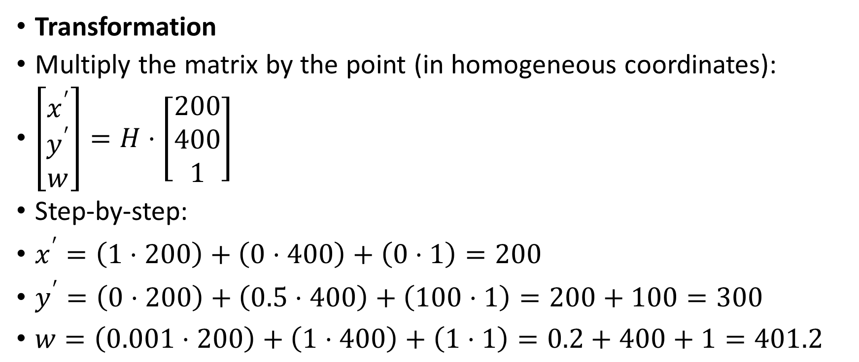
Transformation
Multiply the matrix by the point (in homogeneous coordinates):
$\left[\begin{matrix}x^{′} \\ y^{′} \\ w\end{matrix}\right]=H⋅\left[\begin{matrix}200 \\ 400 \\ 1\end{matrix}\right]$
Step‑by‑step:
$x^{′}=\left(1⋅200\right)+\left(0⋅400\right)+\left(0⋅1\right)=200$
$y^{′}=\left(0⋅200\right)+\left(0.5⋅400\right)+\left(100⋅1\right)=200+100=300$
$w=\left(0.001⋅200\right)+\left(1⋅400\right)+\left(1⋅1\right)=0.2+400+1=401.2$

Slide 27
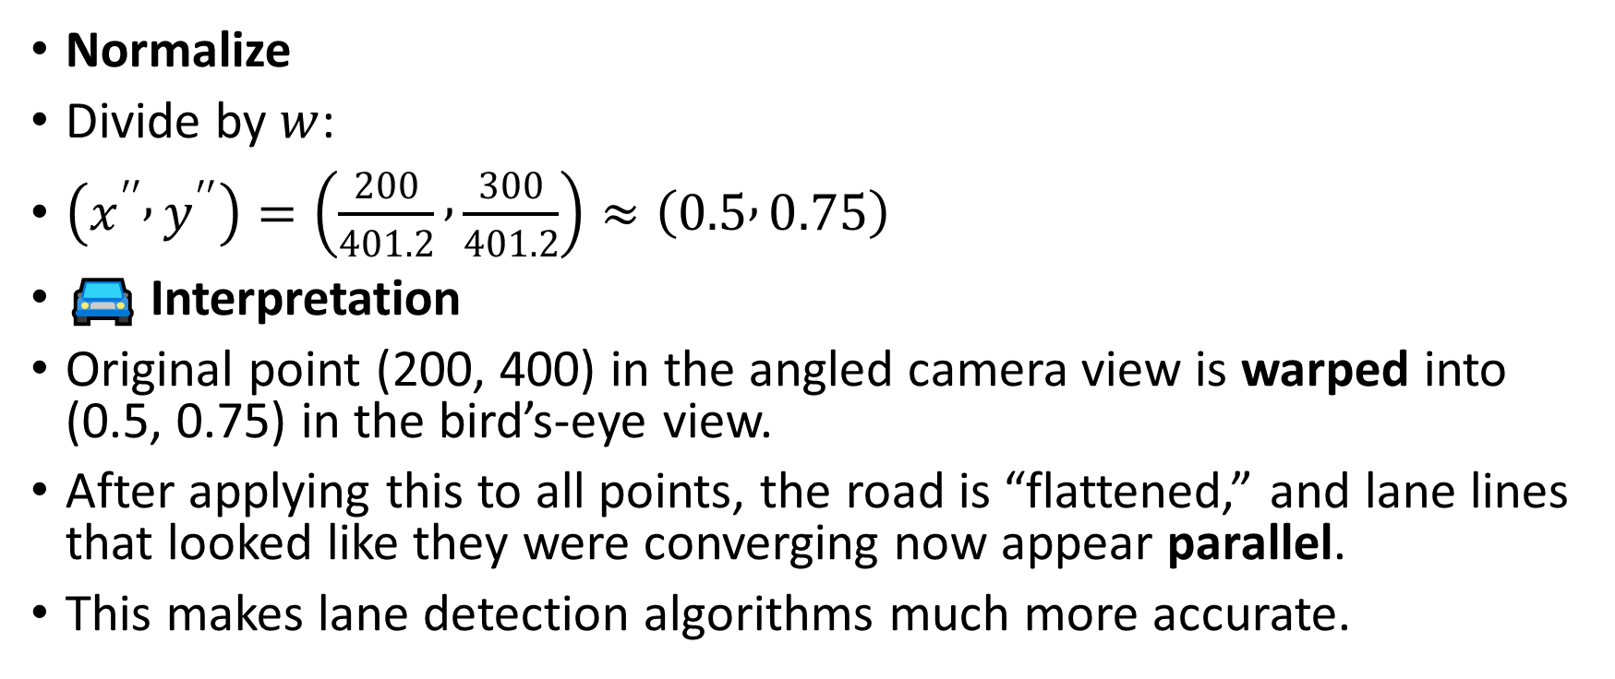
Normalize
Divide by $w$:
$\left(x^{′′} , y^{′′}\right)=\left(\frac{200}{401.2} , \frac{300}{401.2}\right)≈\left(0.5 , 0.75\right)$
🚘 Interpretation
Original point (200, 400) in the angled camera view is warped into (0.5, 0.75) in the bird’s‑eye view.
After applying this to all points, the road is “flattened,” and lane lines that looked like they were converging now appear parallel.
This makes lane detection algorithms much more accurate.

Slide 28
Why VPUs Matter
VPUs accelerate these matrix multiplications for every pixel in the image, so the car can transform the entire frame into bird’s‑eye view in real time.
So, Bon, this is how a homography matrix mathematically reshapes the camera’s perspective into a top‑down view.
👉 Would you like me to extend this into a mini‑pipeline example where we take a few lane points, transform them, and then fit a polynomial curve to model the lane? That would show the full flow from raw pixels → bird’s‑eye view → lane model.

Slide 29
can we see some images on what we are doing? in annotation software i see the pictures of cars and lanes etc. i dont see that here? is it the software or the methodology we are following. how to realate the thing we are dong to the actual car and lanes?
I understand the confusion, Bon. In annotation software you see actual images of cars, lanes, pedestrians, etc. because that’s the data being labeled. What we’ve been doing here — talking about matrices, dot products, and transformations — is the mathematical methodology behind the scenes that powers those annotations.
How It Relates to Real Car Images
Annotation Software (What you see):
Pictures or video frames from car cameras.
Human annotators (or semi‑automated tools) draw boxes around cars, mark lane lines, highlight pedestrians.
These are the visual datasets.

Slide 30
Matrix Operations (What we’re discussing):
Every image in that software is stored as a matrix of pixel values.
When you mark a lane line, the algorithm later uses convolutions, dot products, and transformations on those pixel matrices to detect similar patterns automatically.
The math is invisible in the annotation tool, but it’s what makes the software able to learn from those labeled images.
Bird’s‑Eye Transformation:
In annotation software, you might see a raw camera view.
The methodology (matrix transformations) converts that angled view into a flattened top‑down view.
That’s why in research papers or demos you’ll sometimes see both: the raw camera image and the transformed bird’s‑eye image side by side.

Slide 31
Connecting to the Actual Car
The car’s cameras capture real road scenes → annotation software shows those frames.
Engineers annotate them → labels become training data.
VPUs/GPUs then run the matrix math we’ve been discussing on new, unlabeled frames in real time.
Result: the car can recognize lanes, cars, and pedestrians without human help.
So: software = pictures + labels, methodology = math on matrices, and together they connect directly to the car’s perception system.

